Slide 1

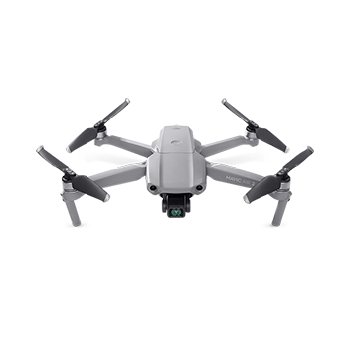
Theoretical Use of Object Detection and Image Segmentation for Wildfire Monitoring Using Drones
By: Steven Cao
Northwood High School

Slide 2
Abstract
Wildfires have been threatening our society these past few months and many acres of land have been burnt as a result. Some wild fires are naturally caused, such as by lightening; however, nearly 85% of the wild fires are human-made. Drones are becoming an increasingly useful asset to firefighters for wildfire monitoring and assessment. The goal of my project is to show that we can have a drone (UAV) and use object detection to find plastic bottles to show that we can monitor wild fires by detecting objects such as people. Using Tensorflow and PyCharm, I built a model that can detect plastic bottle to show that we can detect other objects and monitor wildfires using UAVs.

Slide 3
Problem
Wildfires has been threatening our society and our environment with increasing frequency that are destroying many homes and acres of land.

Slide 4
Introduction
Over the past few years, many wildfires were spotted and have been growing in increasing frequency. In the last few months in Irvine, two wildfires appeared and burned many acres of land, leading to devastation.
Thus, fire detection of early wildfires have become increasingly important.
Many conventional sensors that detects heat, smoke, and fire were used, but were not effective as they usually have short ranges and takes time for the particles to reach of point of sensors and activate them.
Recent advances in computer vision and machine learning offer new tools for detecting and monitoring forest fires.
Figure 1. Pictures of the Silverado Canyon wild fire which started from October 26, 2020 to November 7, 2020

Slide 5
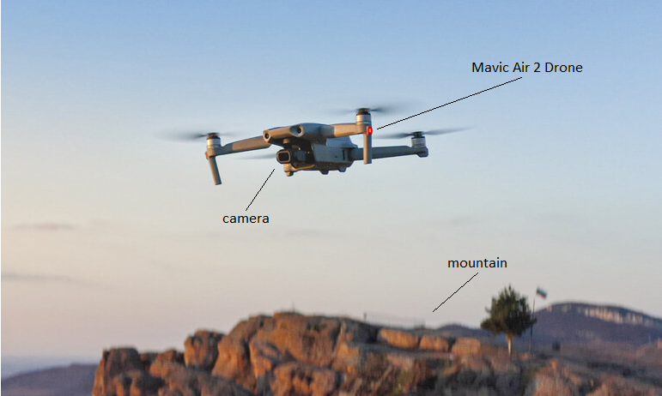
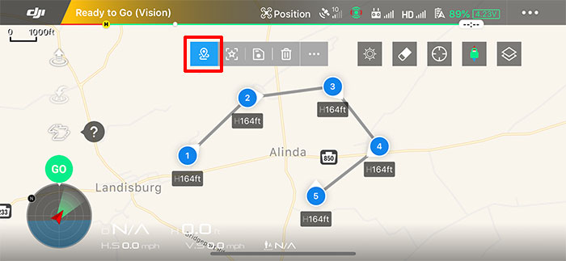
Hypothesis
Figure 3. The drone can be designed a route to fly and we do that by creating waypoints that the drone goes through. This is one way to show that we can let the drone fly and monitor the mountain without needing a controller.
Figure 2. The drone can fly above the mountains to monitor it as shown above
We use Mavic Air 2, because it can fly and fly a designed route that will allow us to monitor mountain regions

Slide 6
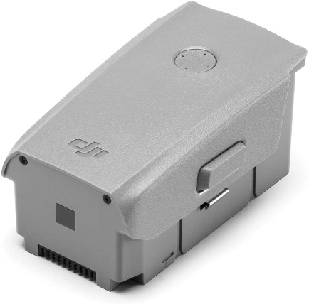
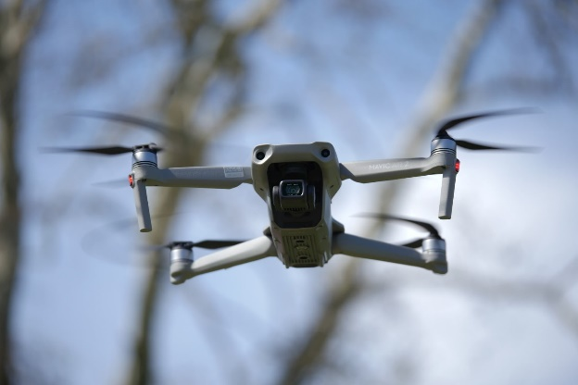


Materials
DJI Mavic Air 2 Drone
1 Plastic bottle
1 Battery (4S Lithium-Ion Polymer)
SD card (SanDisk 128 GB)
PyCharm & Tensorflow
Thousands of images of plastic bottles (test set, training set)
4S Lithium-Ion Polymer Battery
DJI Mavic Air 2 Drone
PyCharm
Tensorflow

Slide 7
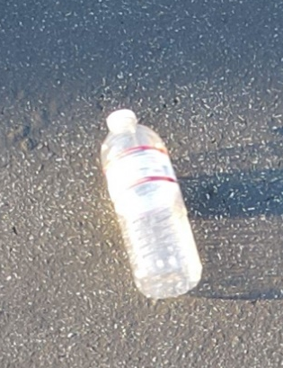
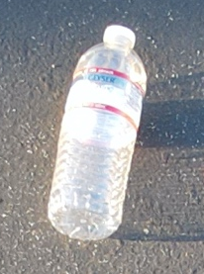
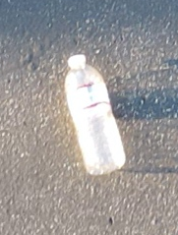
Procedure
The goal of my project is to show that we can have a drone (UAV) and use object detection to find plastic bottles to show that we can monitor wild fires by detecting objects such as people.
Bought a Mavic Air 2 Drone and spent a couple of days learning how to control and fly it easily.
Used the waypoint feature to allow the drone fly in a designed route that can monitor wildfire areas.
Took pictures of plastic bottles using the Mavic Air 2 Drone with varying altitudes for data collection and prediction.
Figure 4. Pictures of plastic bottles taken by the Mavic Air 2

Slide 8
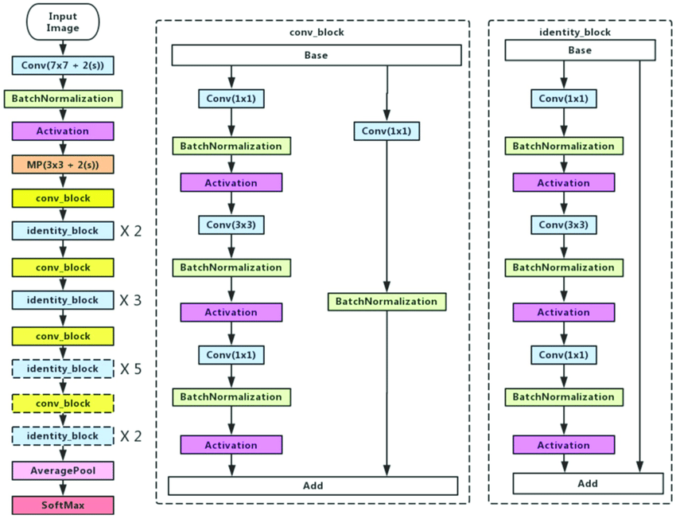
Procedure (continued)
To show that we can do object detection, I built a model that can detect if there are plastic bottles in any image.
I used PyCharm to create a model that detects plastic bottles. The model uses the Residual Networks (ResNet), specifically, we use the ResNet50, an object detection model that has 50 layers.
I then gave the model many different images of plastic bottles to predict to test its quality.
Figure 5. Diagram of the ResNet50 architecture

Slide 9

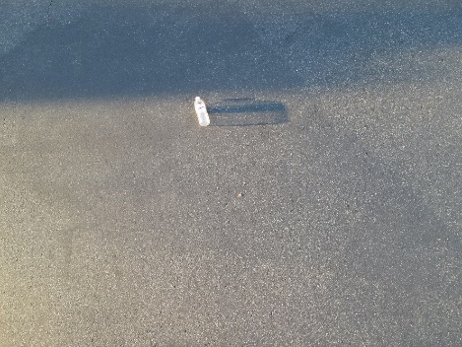
Results
Our code was able to detect plastic bottles using the model. We used the pre-trained ResNet50 model with the ImageNet that had 14 million images and predicted the plastic bottle
Using the images in Figure 6 , the model showed a detection of 'water_bottle’ at 1.272%.
After I cropped the image to fit only the plastic bottle before any pre-processing, results showed that the left image of Figure 7 had a 99.687% probability of being a water bottle while the image on the right side had 99.23% probability of being a water bottle.
Figure 6. Raw Images of a plastic bottle (4000 by 3000)
Figure 7. Cropped Images of Figure 6. before being resized into a 224 by 224 image.

Slide 10
Results (continued)
Results showed a correlation between how far was the drone to the plastic bottle and the accuracy of it being a plastic bottle. However, if I continue cropping the image, the accuracy of the plastic bottle decreased.
When predicting whether it detected a plastic bottle in this image shown in Figure 8, we got results showing that there was a 50.768% probability of being a plastic bottle on the left side and a 70.343% probability of being a plastic bottle. It now had a far lower accuracy compared to the image before
Then I took some pictures of water bottles online to compare against the pictures that I took from the drone.
Results showed promising results, with Figure 9 having a 99.95% probability of it being a water bottle. Figure 10. had a 94% probability of it being a water bottle.
Figure 8. Cropped Images of Figure 7. You can see that cropped the image until the edges of the bottle are at its borders.
Figure 9. Image of a plastic bottle Figure 10. Image of a plastic bottle

Slide 11
Discussions
The environment where I took the pictures could have influenced the prediction of the model.
The results from Figure 9 and Figure 10 shows that the model was given a diverse amount of data and that no overfitting occurred. There was not much difference in the prediction of the online plastic bottles images compared to the prediction of the plastic bottles images taken outside. This shows that the pictures from online does not defer to much from the images taken from the drone, as long as the plastic bottle is the main object in the image.
Possible Explanations: Figure 6. had a 1.272% of detecting a plastic bottle.
The image had 98% empty space, with only that small area having a plastic bottle. So this affected the ResNet50 model, because given that small amount of area, it does not have a lot of data to go off and predict a higher probability of being a plastic bottle compared to anything else.

Slide 12
Conclusions
This work detects plastic bottles using ResNet50 to show that we can detect plastic bottles. It also showed that when monitoring wild fires, the drone should not go too closer to the object, but stay a respectable amount of distance away. It also shows that when doing image segmentation, it should leave some amount of padding to avoid any mistakes. Now we can say that it is a possibility of using UAVs to monitor mountain regions for wildfires by using an object detection model.

Slide 13
Reflection & Application
Our findings suggest that further development of drones as the carrier of camera that can do object detection may provide a more viable and extremely useful alternative to current fire detection devices.
Applications to other studies
Drones can also be used to detect other objects like plastic, animals in a forest for safety, or looking at license plates of cars to see if that car has legal authorization to be parking there.
Follow-up research
More convolutional layers for deeper neural networks to increase accuracy, and testing different neural networks.
Commercial use
UAV that can automatically fly in the mountains to detect any signs of wildfires.

Slide 14
References
Bouabdellah, K.; Noureddine, H.; Larbi, S. Using wireless sensor networks for reliable forest fires detection.Procedia Comput. Sci.2013,19, 794–801
https://csfjournal.com/volume-3-issue-2/2020/10/30/deep-learning-based-fire-recognition-for-wildfire-drone-automation

